Slide 1
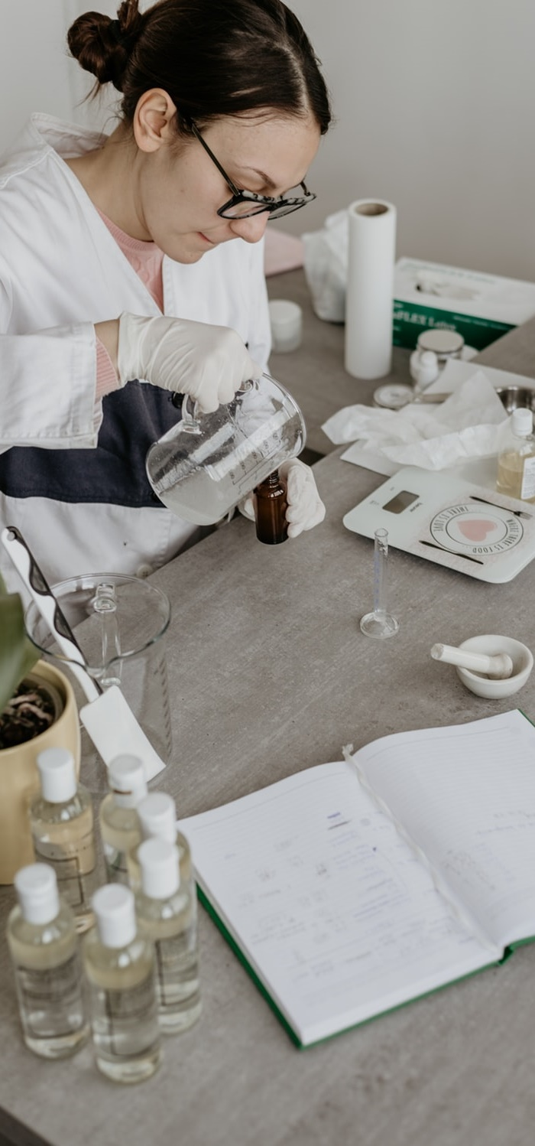
Communications Plan for Launching the Initial Assessment Survey

Slide 2
Purpose of this plan
To aid you in planning and delivering communications for a successful initial assessment survey
Communication objectives
People understand the mission of My Green Lab, why your organization is pursuing certification, and why their participation is important
Encourage at least 50% of lab staff take the initial assessment so you get back meaningful results
Inspire people in the organization to create a culture of sustainability in their labs (and beyond)

Slide 3
Communication phases
The plan covers 3 general phases:
BEFORE THE SURVEY (pre-launch)– generating interest in sustainability and My Green Lab Certification
DURING THE SURVEY (launch)– building participation to get meaningful data
AFTER THE SURVEY (post-launch)– reinforcing learning and building engagement to create a sustainable lab culture
How to use this plan
Use the timing as a guideline for project planning
Use the ideas that you think would work best for your group
Use the enclosed templates as a starting point for developing and delivering your communications

Slide 4
How to use this plan
Customize the table and share it with team as a guideline for project planning
Use the ideas that you think would work best for your group
Use the enclosed templates as a starting point for developing and delivering your communications
Field definitions
Date | Activity | Audience | Purpose/ Messages
When will you deliver the communication? | What is the type of communication? | Who will receive the communication? | Why are you delivering this particular communication and what are the key messages you want to convey?
Materials required | Responsible | Status
What approved copy, slides, images, links, etc. do you need to send the communication? | Who will create? Who will approve? Who will distribute? | Is it done yet? Not started (could leave blank) Draft In review Pending approval Published/complete

Slide 5
Assessment Survey Launch Comms Plan (pre-launch)
Date | Activity | Audience | Purpose/ Messages | Materials required | Responsible | Status
Upon contracting with My Green Lab | Story about your organization and My Green Lab | As broad as possible – e.g. University or company intranet | Raise high-level awareness of your organization’s pursuit of sustainable lab culture and certification & share info re: upcoming survey launch | Approved Article |  | Draft template complete
Ahead of survey if timing aligns | Site/dept newsletter (if applicable) | Site or dept-wide | Raise local awareness of Green Labs Program & share info re: upcoming survey launch | Draft intro & link to intranet article |  | Draft template complete
1 week ahead of launch | email from site/lab Leader | All survey-takers | Reinforce leadership commitment to Green Labs program & emphasize importance of participation | Draft email |  | Draft template complete
Ahead of or during survey period | Department mtg updates | All lab managers | Heads up on upcoming survey launch; request that they reinforce importance of completion in their teams - Provide face-to-face Green Labs update & opportunity to ask questions | Dept Mtg Slides; short or long version depending on time | Approval & distribution– Site lead | Short Dept slide template complete

Slide 6
Assessment Survey Launch Comms Plan (launch & post-launch)
Date | Activity | Audience | Purpose/ Messages | Materials required | Responsible | Status
Day of launch | Internal social media update (if applicable) | Lab or site internal social media group | Heads up – the survey link is coming via email | #greenlabs content, link to mygreenlab.org & intranet article | local leader and team members to post/share | Links complete, use #greenlab; create your own content
TBD during survey weeks | Complete & Eat #x of y (repeat as needed during survey period) | Survey takers/ RSVPs | Give time & food for completing the survey | Plasma screens/ electronic signage/ poster/ FAQ for event facilitators |  | Template poster complete; Draft FAQ complete
During survey period | Survey reminder on electronic signage | All on site | Reminder of survey & event dates; reinforce key messages/reasons for Green Labs | Slides |  | Draft template complete
Middle of survey period | *Survey reminder email #1 | Survey takers | Reminder of survey & event dates; reinforce key messages | Draft email | Send from tool or from team leader | *only if event rsvp rate is low
7-10 days into survey period | Leadership update email | Leadership team/ relevant people managers | Share completion rate to-date with site leadership with possible request to reinforce taking survey with stragglers | Draft email
Final survey week | Green Labs final week check-in | Survey takers | Check in face to face with those who should take survey to see if they have; encourage participation | Green Labs team walk-about plan | Green Labs team to check-in face to face
After survey close | Thank you email | Survey takers | Thanks & final report on participation rate stay tuned for results sharing sessions (confirm timing of results availability with My Green Lab) | Draft email | Send from high-level leader

Slide 7
Next steps
TEXT
TEXT
TEXT
Plan to communicate results & engage assessment takers in action planning

Slide 8
Thank you
mygreenlab.org
info@mygreenlab.org
Image: https://www.copolinternational.com/en/professional-uses/medical-sterilization-autoclave-products-cpp-film

