Slide 1
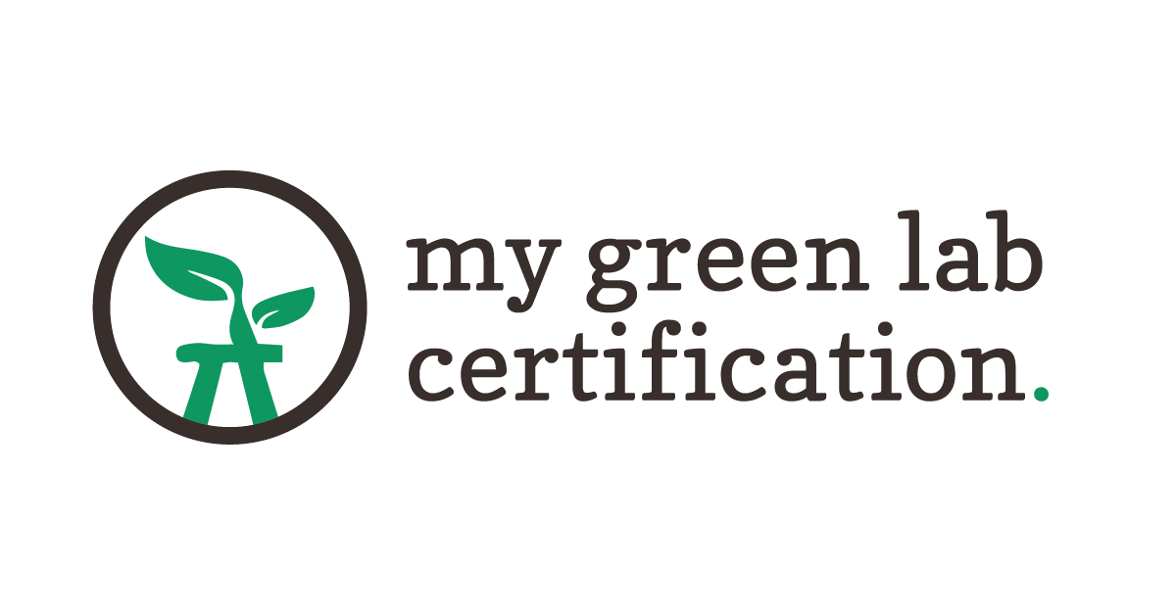
Building a global culture of sustainability in science
Sustainable Purchasing and Resource Managemetn
Notes:
Start with a round of introductions for everyone on the call

Slide 2
The Decade of Action
Notes:
The united nations has declared this the decade of action – the 10 years that are the most critical for us do something big and limit global temperature increases to just 1.5C if we are going to avoid the worst impacts of climate change. This is a big challenge and we have just 8 years left to do something amazing. But the good news is, there are a lot of people all over the world who are working on this.

Slide 3
The Carbon Impact of Biotech And Pharma
Notes:
This last yearmy green lab, wrote a paper on the carbon impact of the biotech and pharmaceutical industry. We looked at publicaly reported and inferred data for over 230 companies in biotech and pharma. And what we found was staggering.

Slide 4
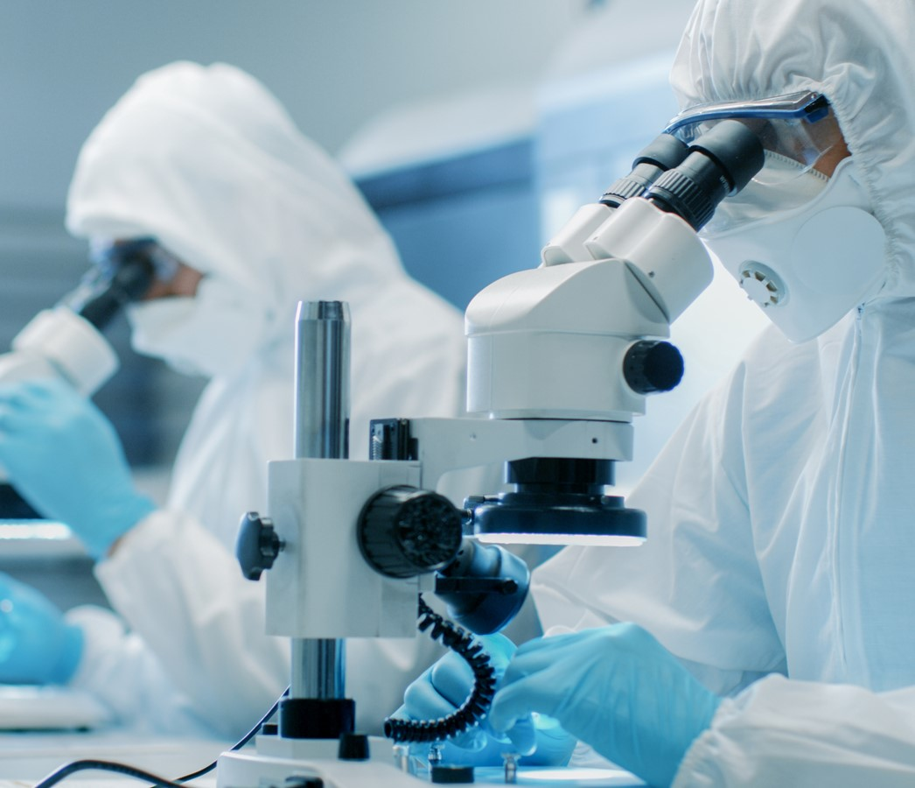
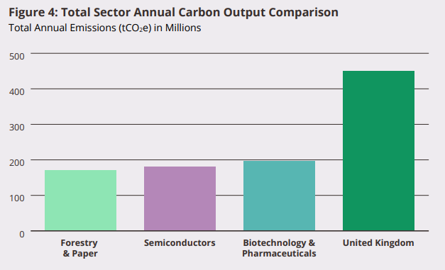
Summary of Key Findings
01
The global biotechnology and pharmaceutical industry has a significant carbon footprint (197 million tCO₂e), more than the forestry and paper industry, the semiconductor industry, and equal to nearly half the annual carbon output of the United Kingdom.
Notes:
The biotechnology and pharmaceutical industry is the 25th-largest carbon-emitting industry in the world. The total carbon output of the industry was 197 million tCO2-e, which is more than the total emissions of the semiconductor industry (182 million tCO2-e) and the forestry and paper industry (170 million tCO2-e), both substantial contributors to global climate change in their own right. More surprising still, the industry’s output is nearly half the annual emissions of the UK in 2020 (414 million tCO2-e). It is imperative that this industry address its carbon footprint and quickly.
Considering only Scope 1 and 2, the biotechnology and pharmaceutical industry is very carbon-intensive, ranking 15th out of 38. While the industry needs to evaluate and address the entire value chain, emissions from Scope 1 and 2 remain crucial opportunities for carbon savings, so biotech and pharma must not ignore the impact of their operations. Directly controlled emissions, however, are only a portion of the industry’s overall carbon footprint.

Slide 5
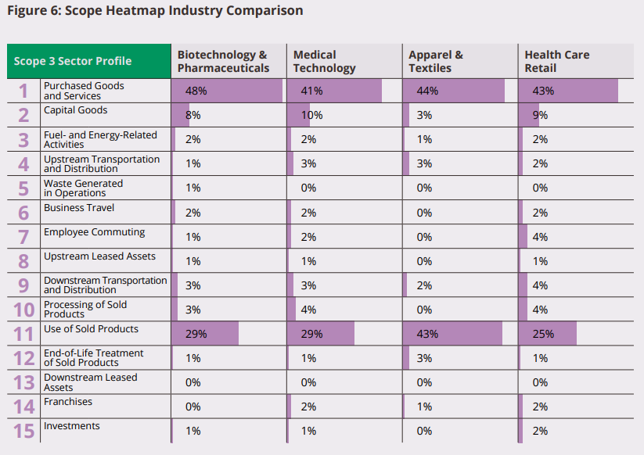
Summary of Key Findings
02
Scope 3 emissions are nearly five times larger than Scope 1 and 2 emissions combined, therefore it is critical to consider the entire value chain when evaluating the carbon footprint of biotech and pharma.
Notes:
The biotechnology and pharmaceutical industry is the 25th-largest carbon-emitting industry in the world. The total carbon output of the industry was 197 million tCO2-e, which is more than the total emissions of the semiconductor industry (182 million tCO2-e) and the forestry and paper industry (170 million tCO2-e), both substantial contributors to global climate change in their own right. More surprising still, the industry’s output is nearly half the annual emissions of the UK in 2020 (414 million tCO2-e). It is imperative that this industry address its carbon footprint and quickly.
Considering only Scope 1 and 2, the biotechnology and pharmaceutical industry is very carbon-intensive, ranking 15th out of 38. While the industry needs to evaluate and address the entire value chain, emissions from Scope 1 and 2 remain crucial opportunities for carbon savings, so biotech and pharma must not ignore the impact of their operations. Directly controlled emissions, however, are only a portion of the industry’s overall carbon footprint.

Slide 6
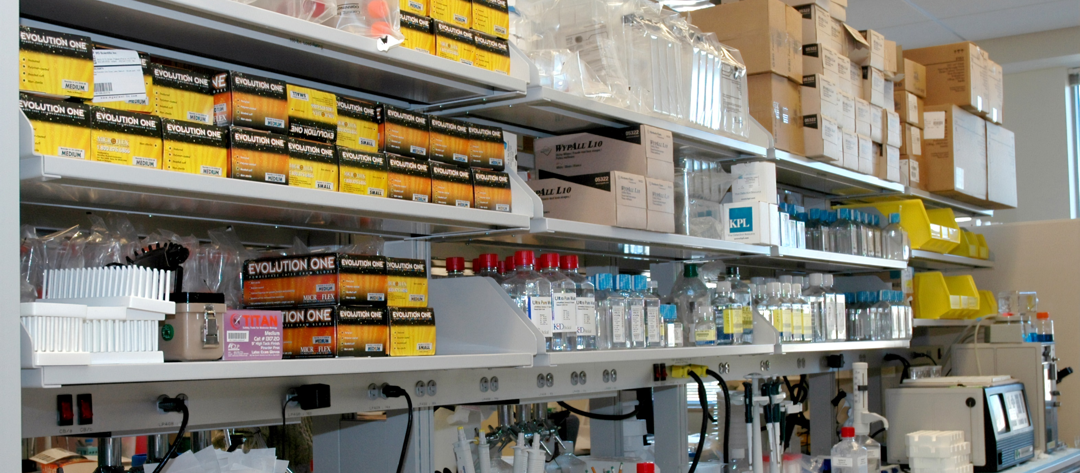
The Takeaway
Sustainable procurement is essential to reducing the impact of our labs!

Slide 7
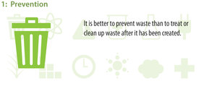
Sustainability Labels
Thermo Fisher
MilliporeSigma
Sustainability Labels can help you
Make quick comparisons between two products
Make more informed purchasing decisions
But beware…
There is little oversight on the use of eco-labels and some are misused
Thermo Fisher added a green leaf to product search results to call out items with attributes such as less waste, uses fewer resources, energy efficient, sustainable packaging, or sustainable disposal.
In the MilliporeSigma product search platform, you can search for items based on their alignment to "Green Alternative Principles", which are based on the 12 Principles of Green Chemistry.
7
Notes:
https://www.etcc-ca.com/sites/default/files/reports/ceel_market_assessment_et14pge7591.pdf

Slide 8
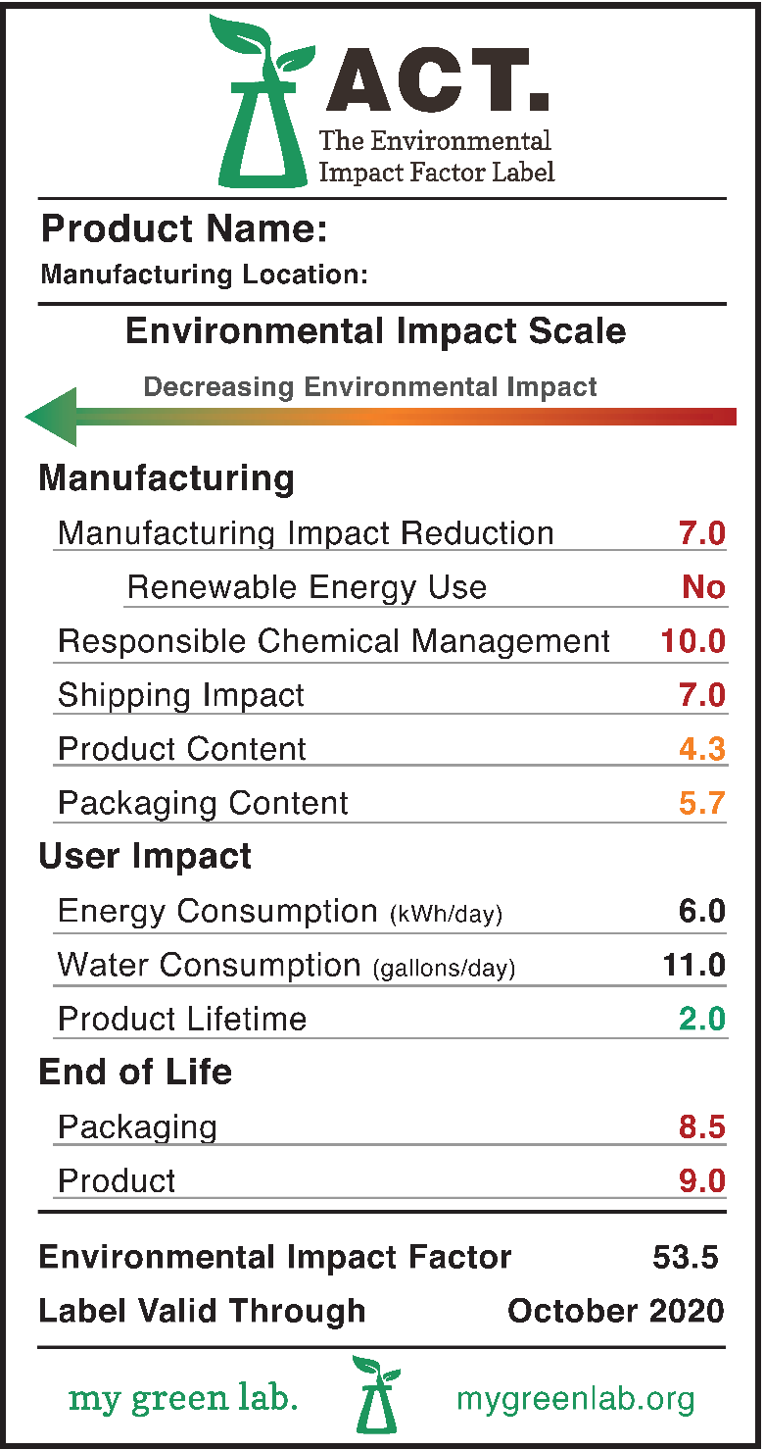
The ACT Label
Sustainability Labels can help you
Make quick comparisons between two products
Make more informed purchasing decisions
But beware…
There is little oversight on the use of eco-labels and some are misused
ACT.
Accountability Consistency Transparency
www.act.mygreenlab.org/
an eco-nutrition label for laboratory products
Notes:
https://www.etcc-ca.com/sites/default/files/reports/ceel_market_assessment_et14pge7591.pdf

Slide 9
The ACT Label
2,400+ ACT labels can be viewed at act.mygreenlab.org
Manufactures big and small such as Thermo Fisher, Eppendorf, Priorclave, Merck, Labcon, Agilent and more
Industry validated:
100% Re-Certification rate
Manufacturers increasing catalogue coverage each year
Many pharma, biotech & academic institutions committing to reducing supply chain environmental impact and using ACT
Engagement across the US, Europe and wider
Notes:
https://www.etcc-ca.com/sites/default/files/reports/ceel_market_assessment_et14pge7591.pdf

Slide 10
Reading the ACT Label
Simple color scale indicates environmental impact, with values on a scale of 1 to 10
LOWER NUMBER
=
LOWER ENVIRONMENTAL IMPACT
Additional information about categories available online
1
10
Energy and water consumption data help drive sustainable lab practices
Lowest Score
Highest Score
Total Impact Factor enables quick comparisons
Expiration date keeps data current and drives continuous improvement
10
Notes:
https://www.etcc-ca.com/sites/default/files/reports/ceel_market_assessment_et14pge7591.pdf

Slide 11
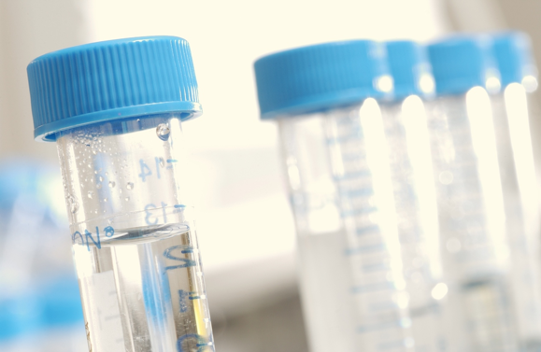
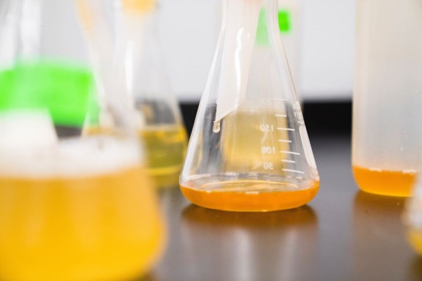
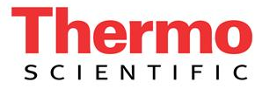
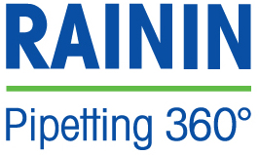
ACT Categories
Chemicals and Reagents
Consumables
Equipment
Tips, conical tubes, microcentrifuge tubes, screw tops, flasks, graduated cylinders and more!
Antibodies, reagents, gel stains
LCs, freezers, microscopes, glassware washers, autoclaves and more
Notes:
https://www.etcc-ca.com/sites/default/files/reports/ceel_market_assessment_et14pge7591.pdf

Slide 12
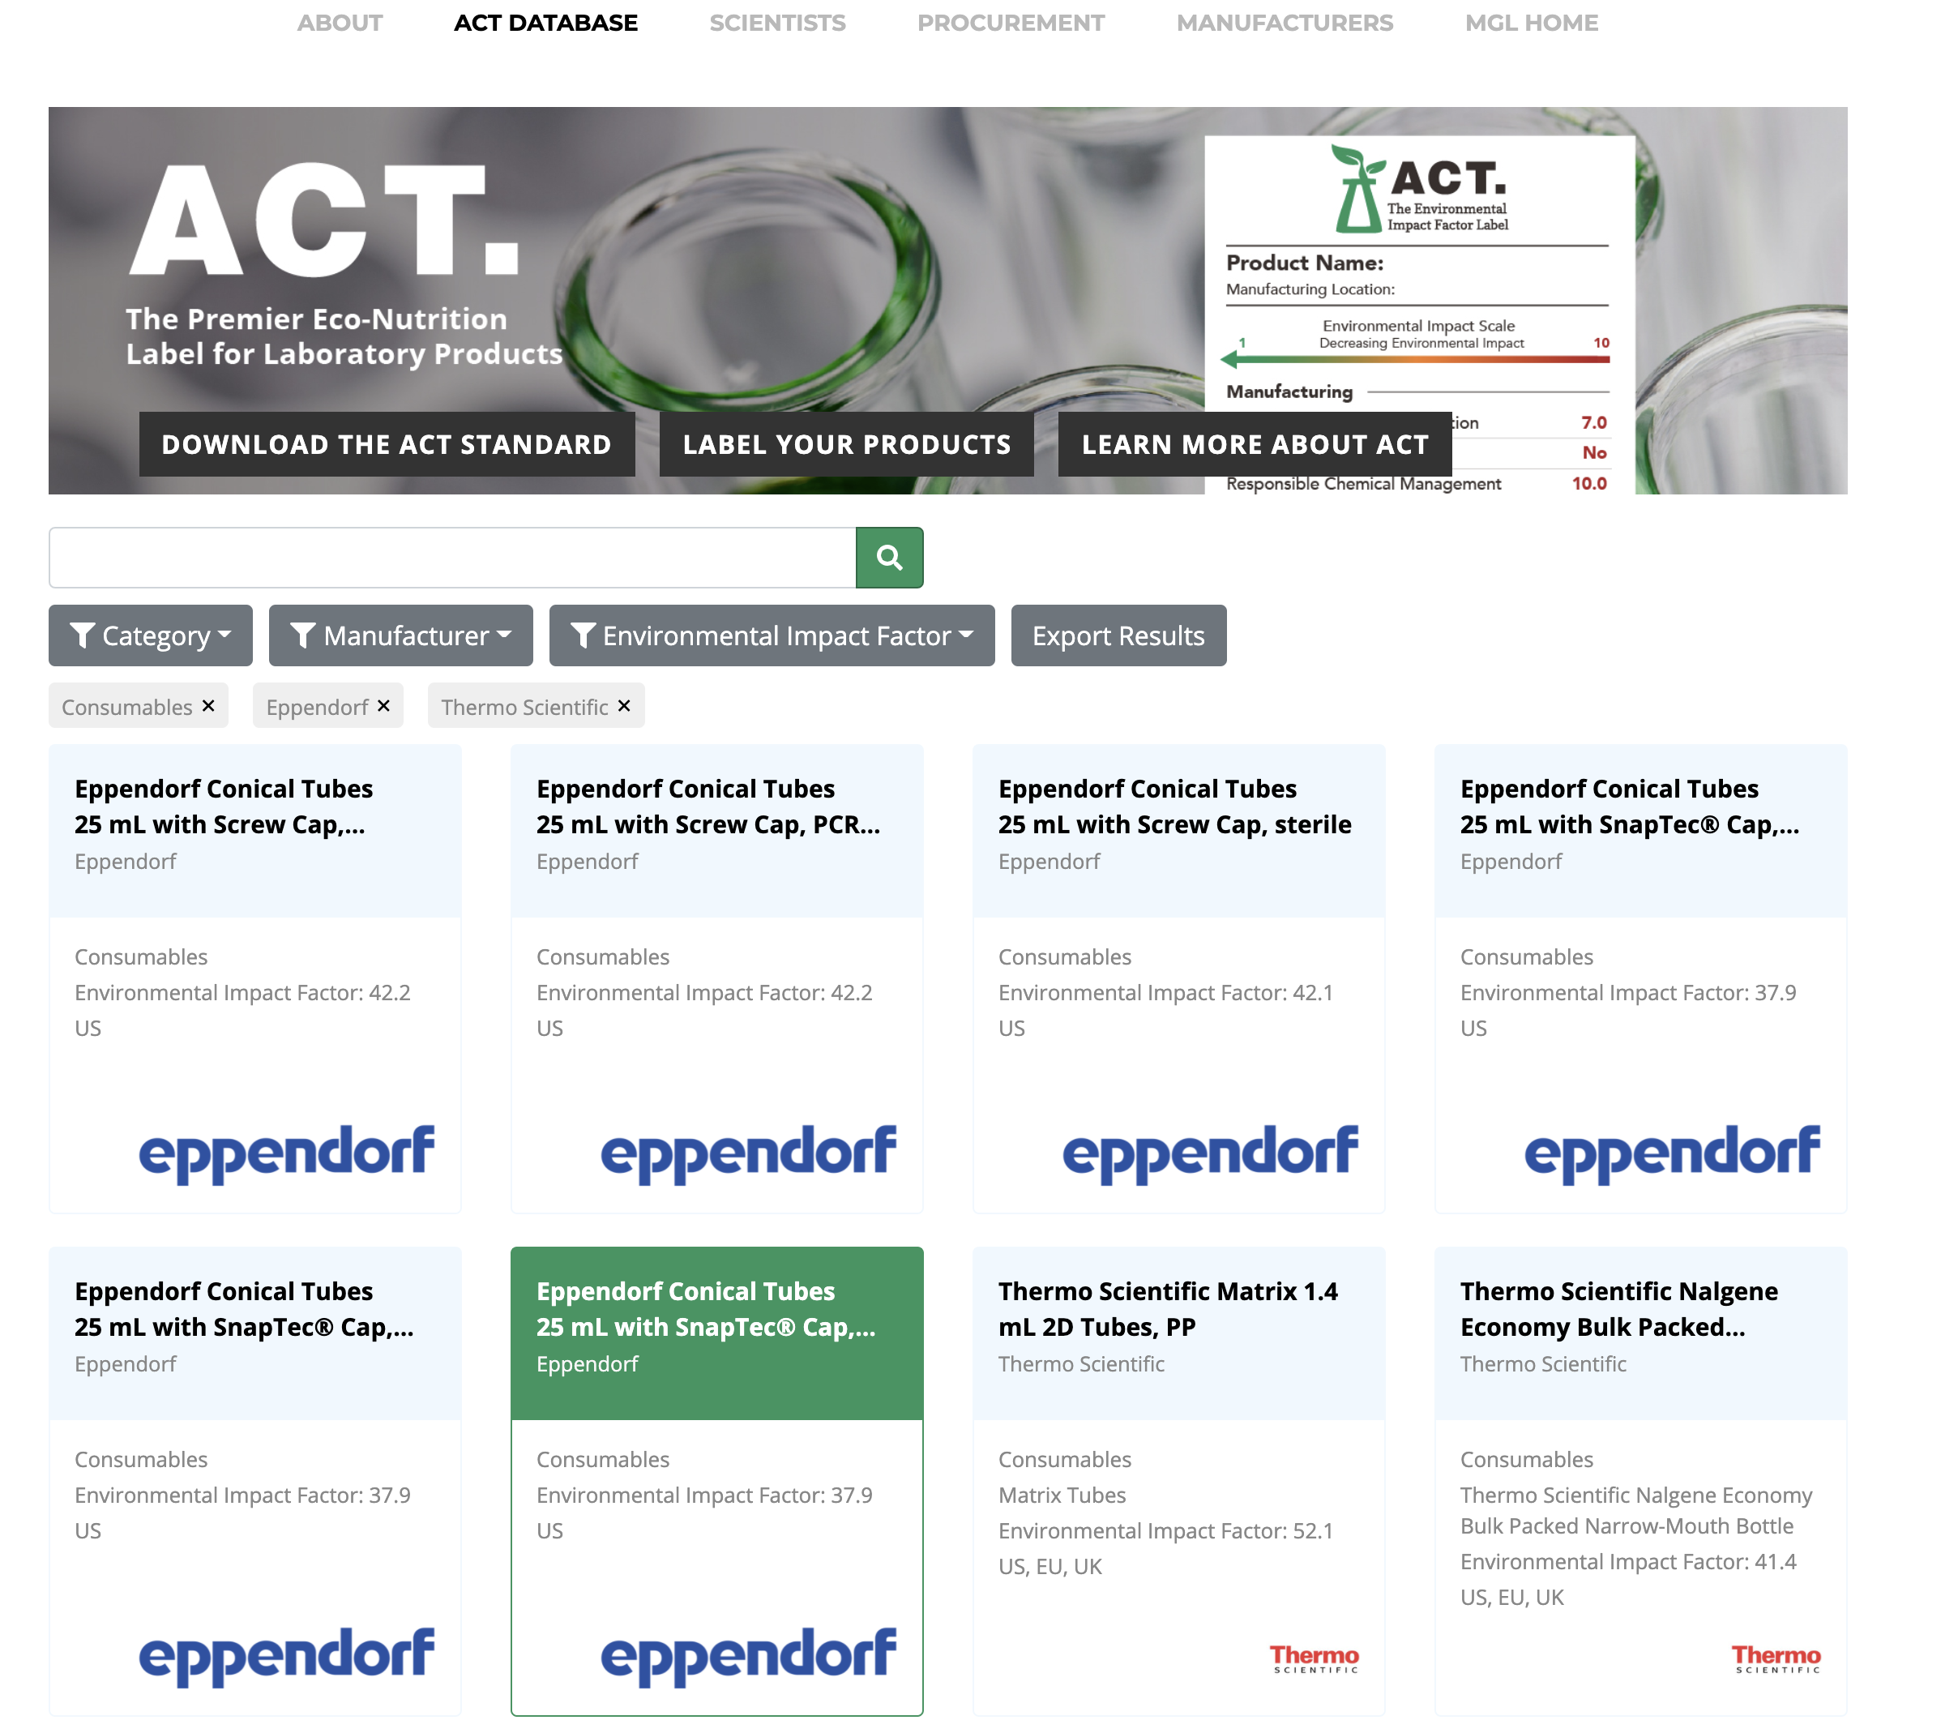
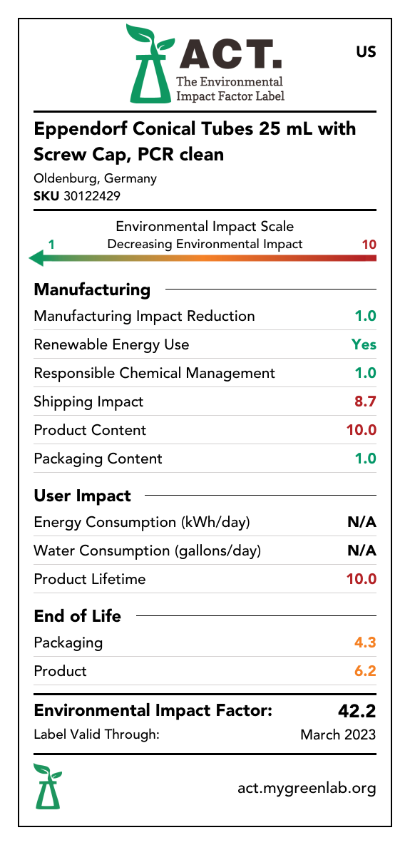
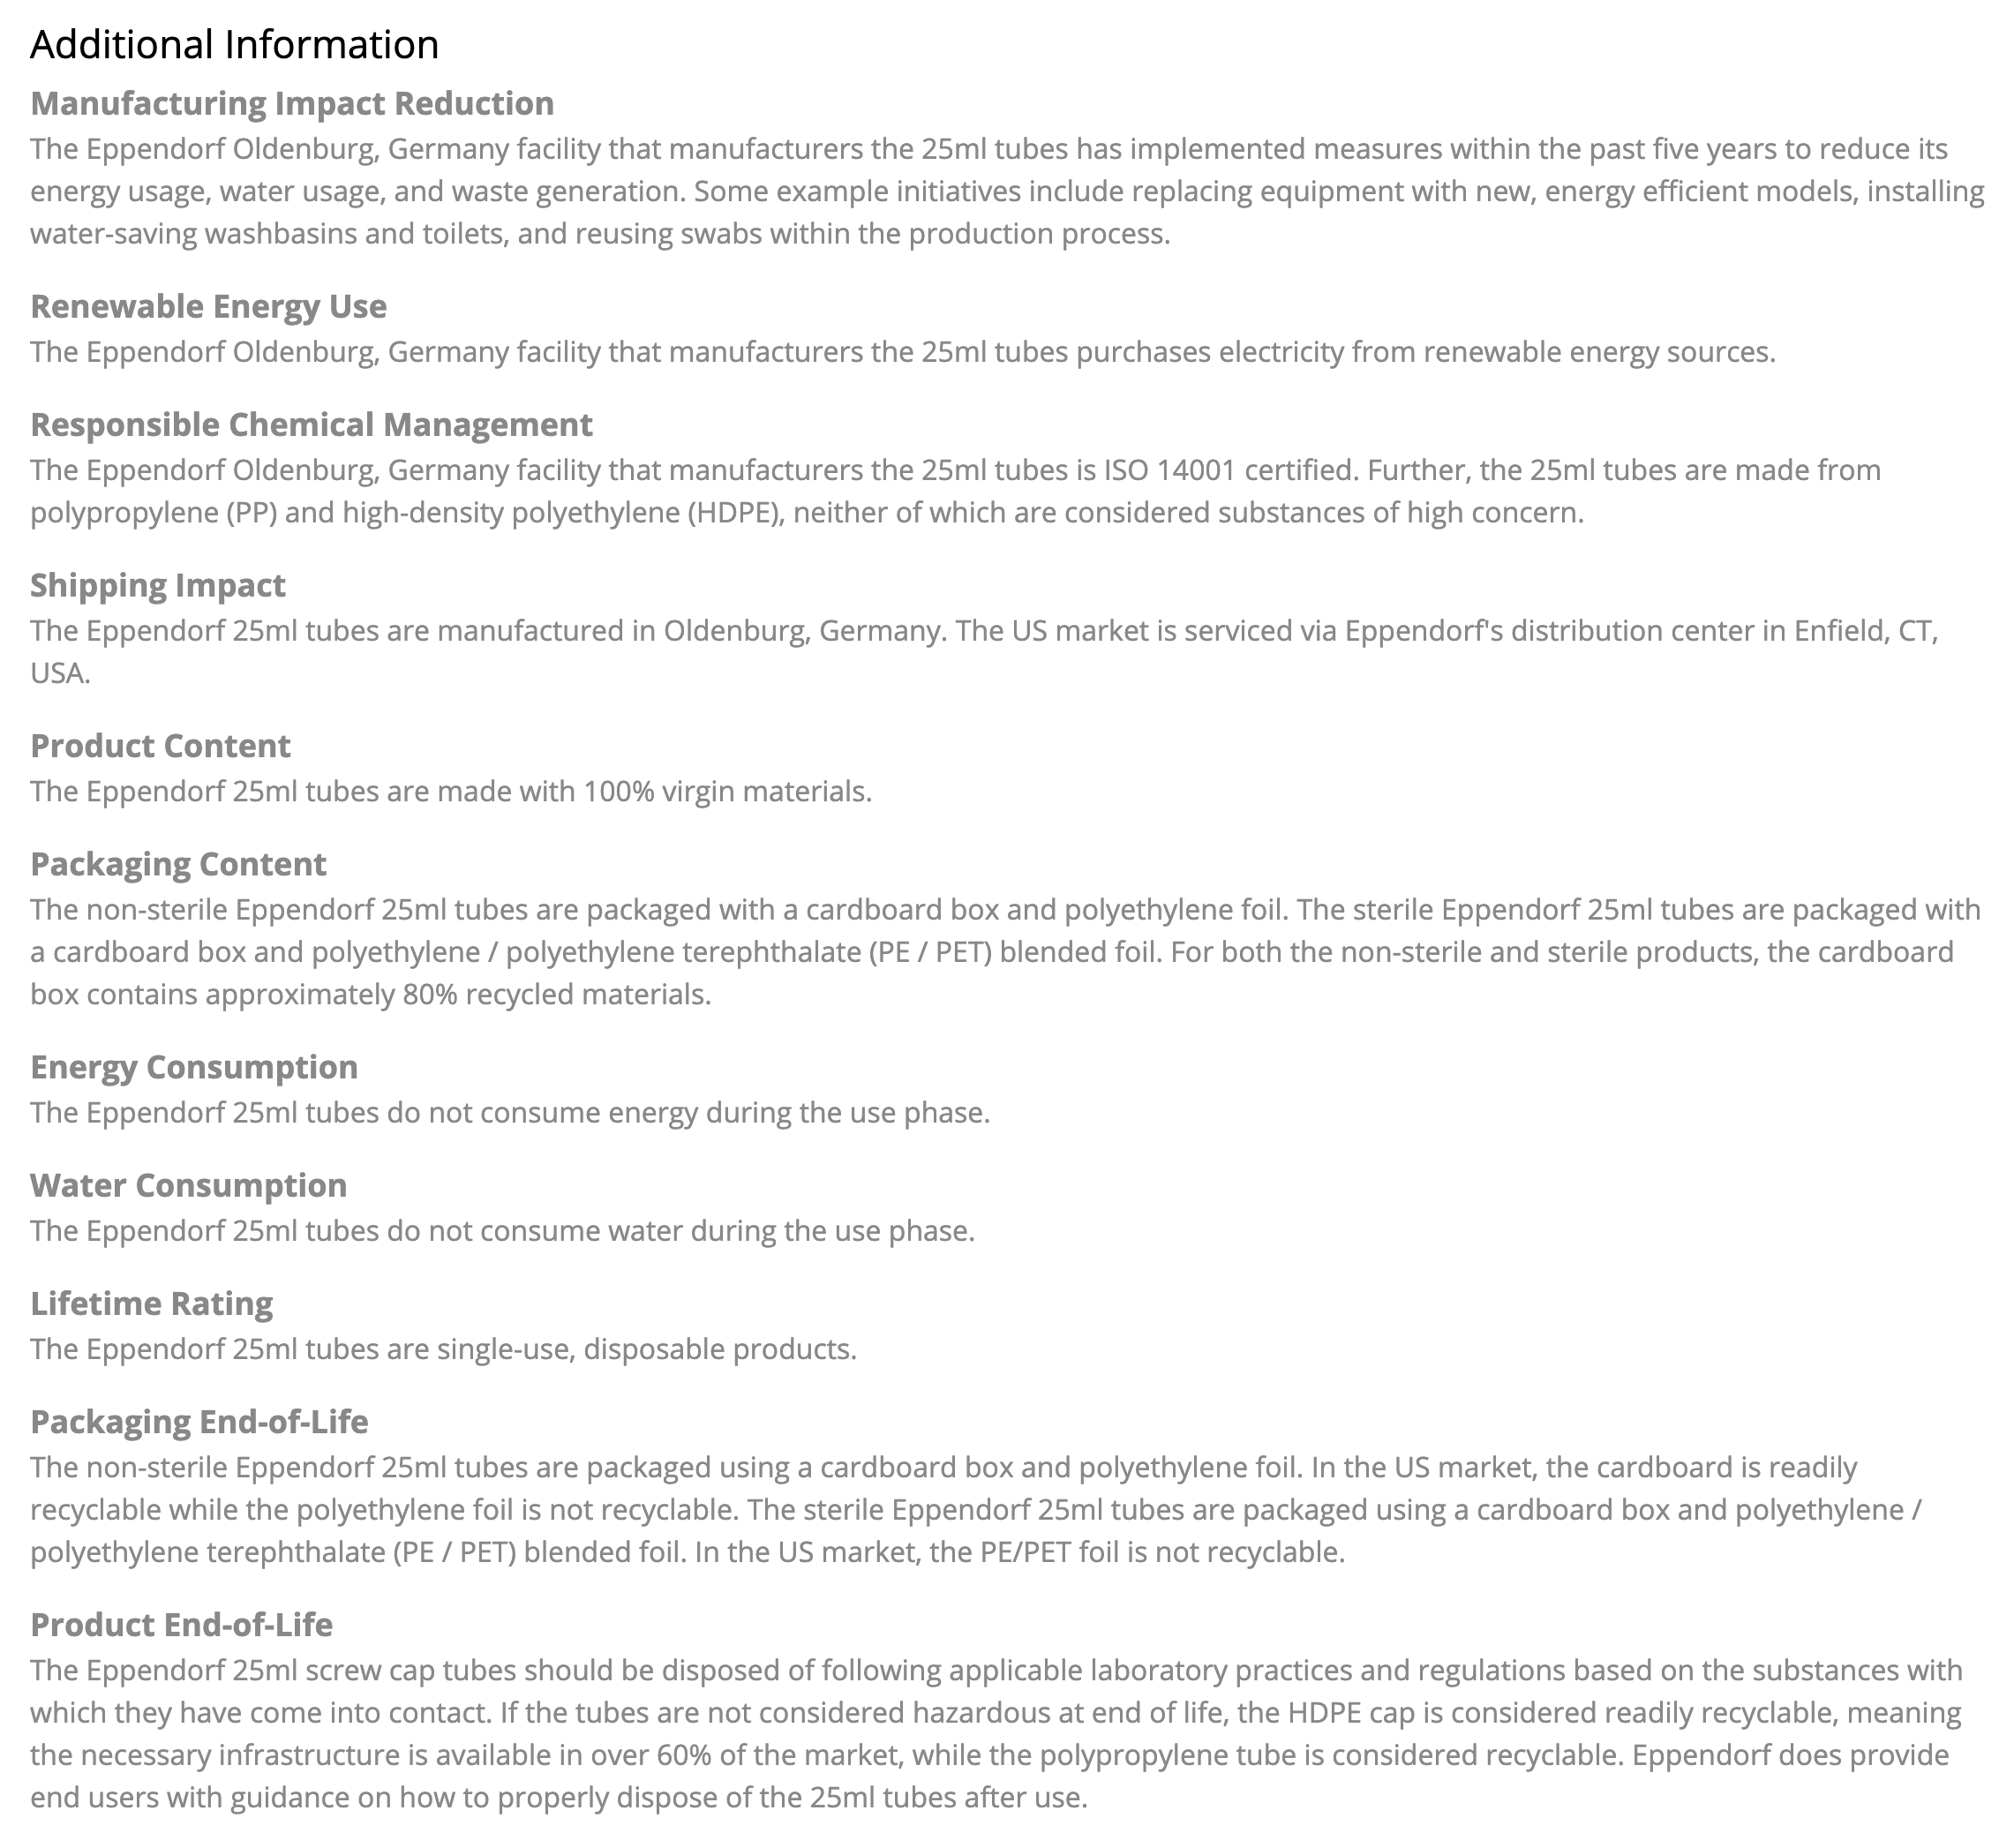
Finding ACT Labels
https://actdatabase.mygreenlab.org/
Notes:
https://www.etcc-ca.com/sites/default/files/reports/ceel_market_assessment_et14pge7591.pdf

Slide 13
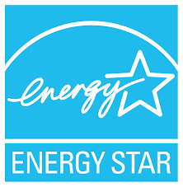
Other Sustainability Labels
Third-Party Certification |  | Definition
Biodegradable Products Institute (BPI) |  | BPI is a non-profit organization with the largest certification program for compostable products and packaging in North America. Their single-attribute certification indicates compliance with the ASTM D6400 and/or D6868 standards for commercial compostability. Products with compostability attribute must be third party certified compostable according to the US Standard ASTM D6400 and/or ASTM D6868.
Cradle to Cradle |  | Cradle to Cradle is a multi-attribute standard that evaluates a wide range of products across five categories of human and environmental health, including Material Health, Material Reutilization, Renewable Energy and Carbon Management, Water Stewardship, and Social Fairness. Product certification is awarded at five levels, from Basic to Platinum, with an emphasis on continuous improvement.
ENERGY STAR® |  | Energy Star is a standard for energy efficient consumer products administered by the U.S. Environmental Protection Agency and the U.S. Department of Energy.
GREENGUARD® |  | The GREENGUARD Environmental Institute certifies products and materials for low chemical emissions. Greenguard Gold ensures that a product is safe for use in schools and healthcare facilities, and is referenced by LEED.
WaterSense® |  | WaterSense is a U.S. Environmental Protection Agency program designed to encourage water efficiency in the United States through the use of a special label on consumer products.
13
Notes:
https://www.etcc-ca.com/sites/default/files/reports/ceel_market_assessment_et14pge7591.pdf

Slide 14
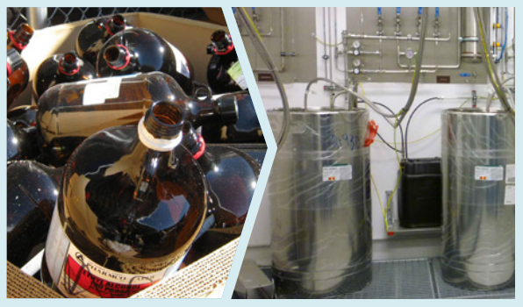
Managing the Ordering Process
Right-sizing Purchases
Don’t buy more than you need
Buy the right volume for your usage rate
If you have excess reagents in a kit – let the supplier know!
In Thermo Fisher Scientific's Zero Waste Guide, they note that switching from 4L bottles to bulk containers of solvents has had significant cost savings for several of their sites— both from a procurement spend and waste disposal standpoint.
Building a Culture of Sustainability in Science
14

Slide 15
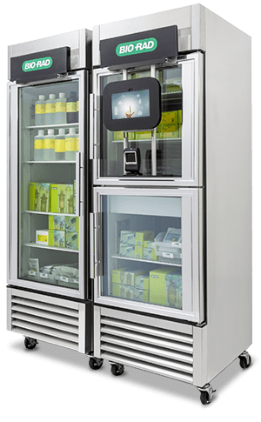
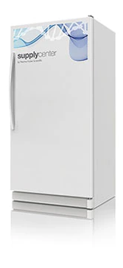
Managing the Ordering Process
Consolidating Orders
Use a spreadsheet or whiteboard to track orders
Place the minimum number or orders with each supplier each week
Consolidate suppliers as much as you can
Use supply centers or local stock rooms that allow consolidated shipments for common items
Bio-Rad Supply Center
Thermo Fisher Supply Center
15

Slide 16
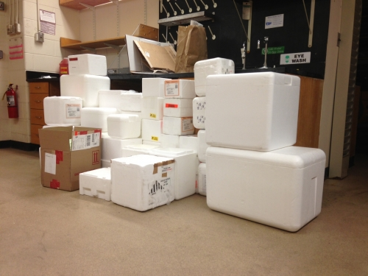
Managing the Ordering Process
Minimizing Orders
Use local networks and suppliers to find refurbished equipment
Share inventory within the lab/company
Image source: https://green.harvard.edu/news/styrofoam-study-mcb-seeks-minimize-lab-waste
16

Slide 17
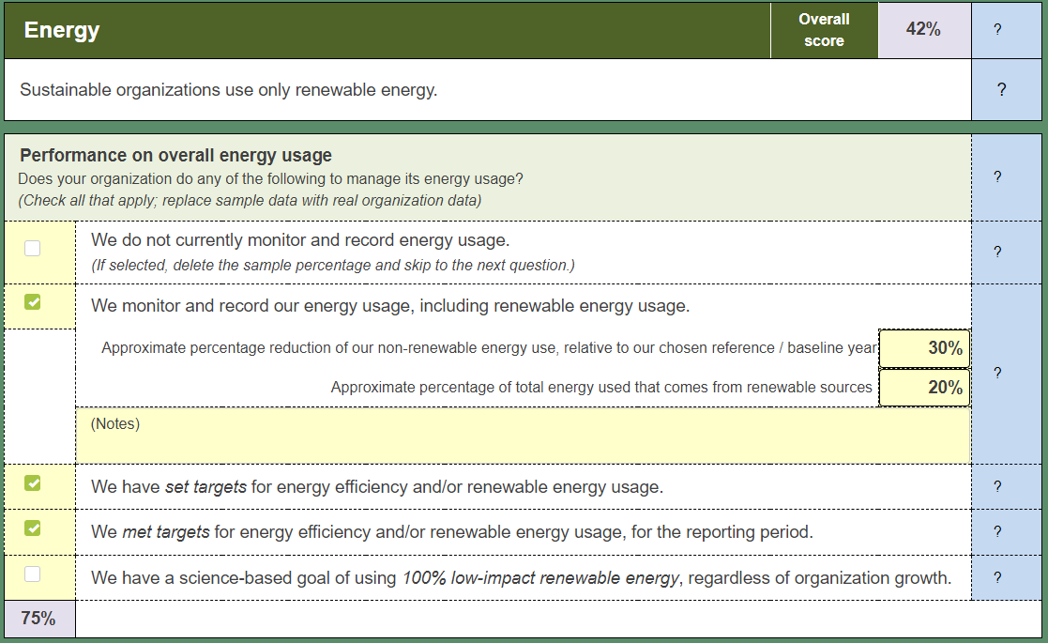
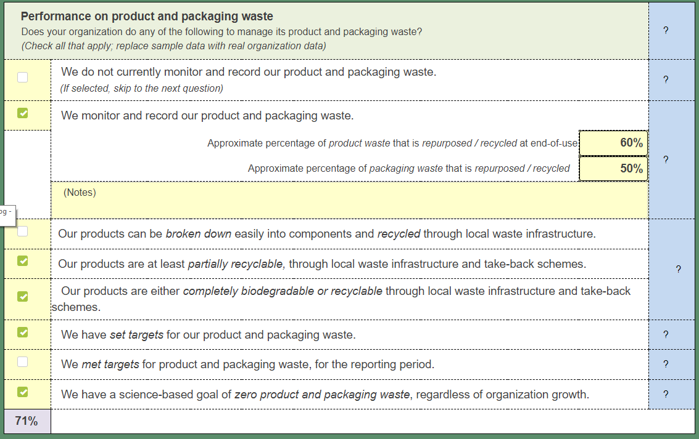
Sustainable Procurement Strategies
Supplier Scorecards
Can be used when you send out an RFP / RFQ
Ask suppliers questions that will help you determine
If they are an ethical supplier
If they have taken steps to reduce manufacturing impact
What environmental features the products or services they are quoting have
Free Resource: https://sustainabilityadvantage.com/assessments/bsat/
17

Slide 18
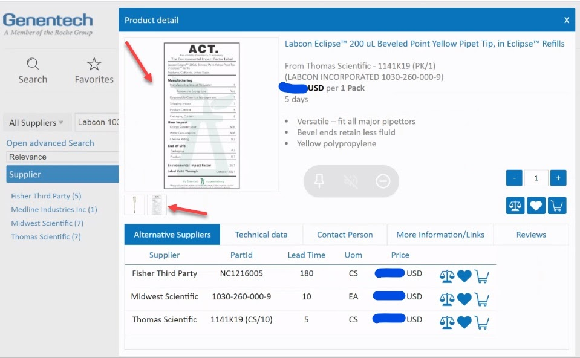
Sustainable Procurement Strategies
Incorporate into Procurement Systems
Use fields to mark preferred products (leaf, tree, globe)
If possible, include eco-labels to give more visibility into preferred products
Building a Culture of Sustainability in Science
18

Slide 19
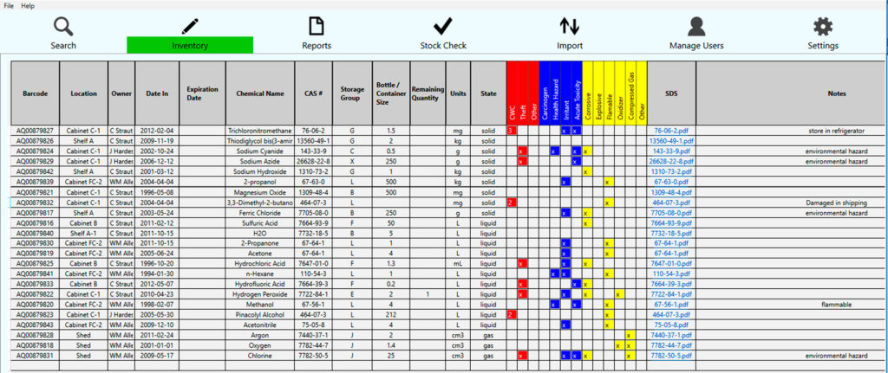
Managing Resources in the Lab
Inventory!!
Know what you have and where you have it
Don’t over order materials that you already have
Helps with safety audits!
Free Resource:
https://gcbs.sandia.gov/tools/cms/
Building a Culture of Sustainability in Science
19

Slide 20
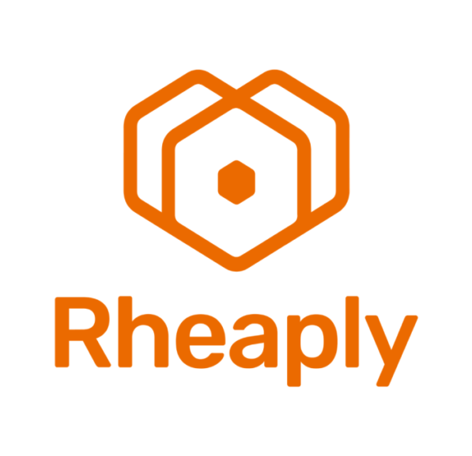
Managing Resources in the Lab
Additional Strategies
Share equipment, supplies and chemicals locally
Utilize equipment return and refurbishment programs
Ask about supplier take-back programs
Explore solvent recycling
Re-use packaging – gel packs, coolers for shipments to collaborators
https://rheaply.com/
More info here:
https://www.mygreenlab.org/waste.html
Building a Culture of Sustainability in Science
20

Slide 21
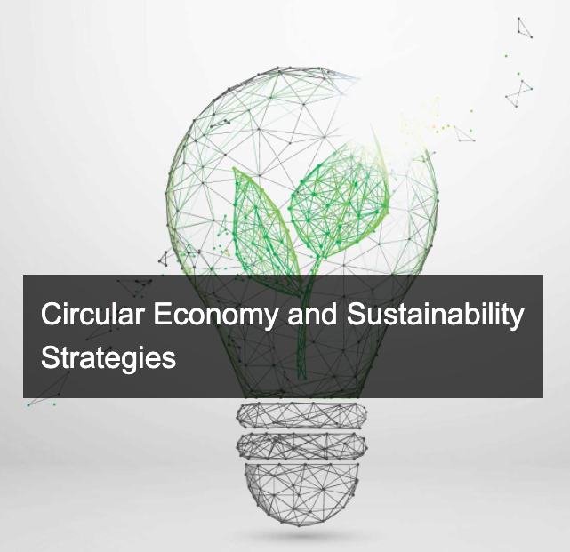
Additional Resources
The Sustainable Purchasing Leadership Council (SPLC) convenes buyers, suppliers, and public interest advocates to develop programs that simplify and standardize sustainable purchasing efforts by large organizations. If your organization isn't already a member, suggest to your purchasing department/team that they consider joining the council.
The University of Cambridge offers a program on Circular Economy and Sustainability Strategies, designed "to help you understand the growing business case for sustainable solutions and to learn how to manage and grow a sustainable business by incorporating circular economy principles into your strategies."
Looking for something faster and more affordable? The open learning platform Udemy offers a course entitled Sustainable Procurement: A Guide to Ethical Purchasing, created by Astrapto, which gives a broad introduction into the topics involved in sustainable purchasing.
Columbia University's Masters in Sustainable Management is for "those who wish to pursue a career in management that takes into account both the environment and the economy." Focus areas such as economics, quantitative analysis, and policy help ensure that graduates will "transform how organizations do business by formulating and implementing sustainability strategies."

