Slide 1
Building a global culture of sustainability in science
Addressing Plug Load in the Lab
Notes:
Start with a round of introductions for everyone on the call

Slide 2
What is Plug Load?
Everything that you plug into the wall
Pipettes
Shakers
Computers
Lasers
Microscopes
Centrifuges
Freezers
etc.
Building a Culture of Sustainability in Science
2

Slide 3
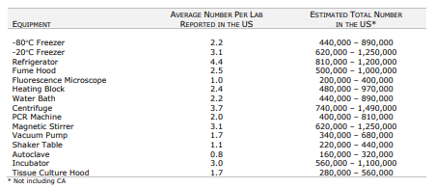
Plug Load
Data Source
Plug Load in California alone is 790-3200 GWh/year
Per Capita energy use in Sweden is 11,800 kWh
That means plug loads in California labs consume the same energy as 67k-270k Swedes
3
Notes:
https://www.etcc-ca.com/sites/default/files/reports/ceel_market_assessment_et14pge7591.pdf

Slide 4
Plug Load
Data Source
Plug Load in California alone is 790-3200 GWh/year
Per Capita energy use in Sweden is 11,800 kWh
That means plug loads in California labs consume the same energy as 67k-270k Swedes
4
Notes:
https://www.etcc-ca.com/sites/default/files/reports/ceel_market_assessment_et14pge7591.pdf

Slide 5
Top Candidates
Equipment that pulls the most power
Anything with a heating or cooling element
e.g. water baths, drying ovens, incubators, freezers
Anything that pulls a vacuum
e.g. vacuum pumps, mass spec, gloveboxes
Building a Culture of Sustainability in Science
5

Slide 6
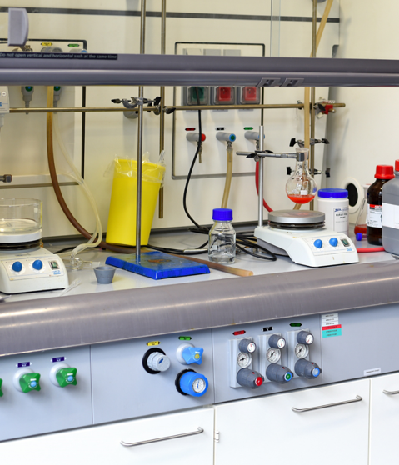
Energy in Labs
If we could cut US plug load by 10% it would be equivalent to removing 550,000 cars from the road
chart from Alison Farmer, kW Engineering

Slide 7
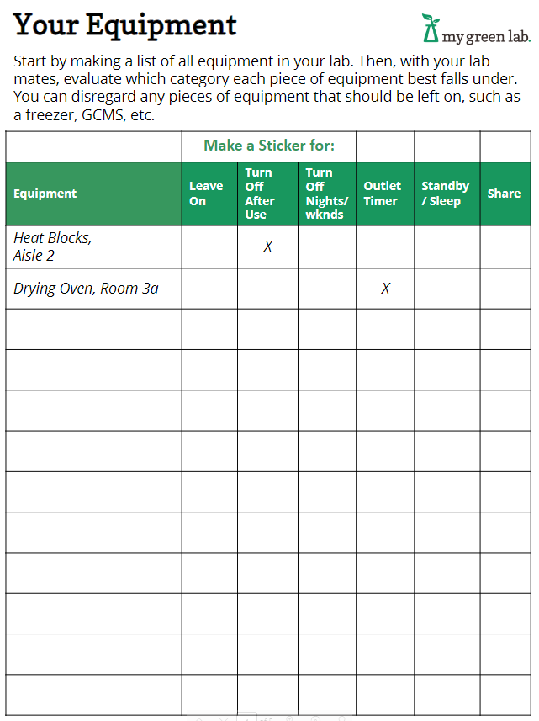
Addressing Plug Load – Where to Start
Determine what you can and cannot turn off:
Candidates for turning off
Ovens
Pumps
TC Hoods
Computers
Thermocyclers
Water baths
HPLC
Not candidates for turning off
Mass spec
Freezers / refrigerators
Plug Load Worksheet

Slide 8
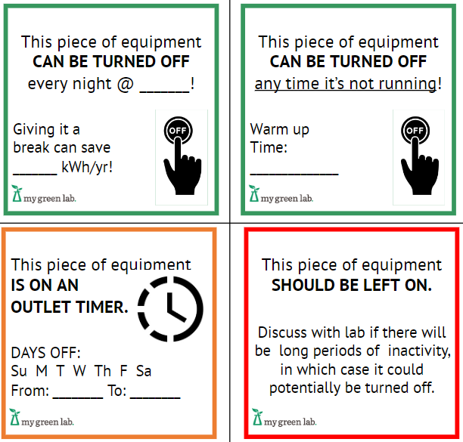
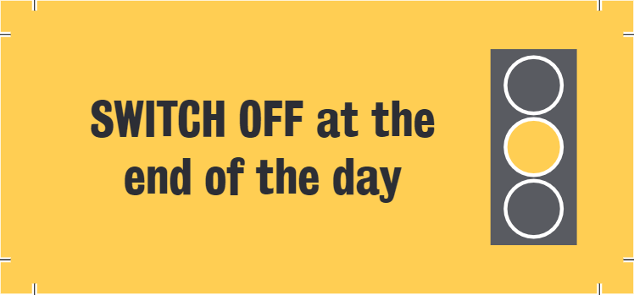
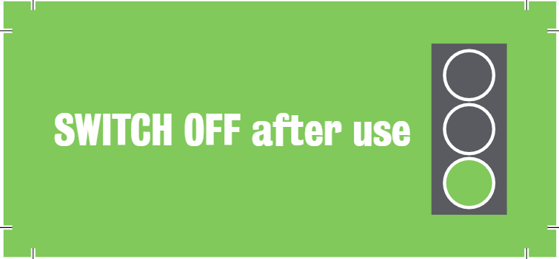
Stickers Make it Known
Sticker 1
Sticker 2

Slide 9
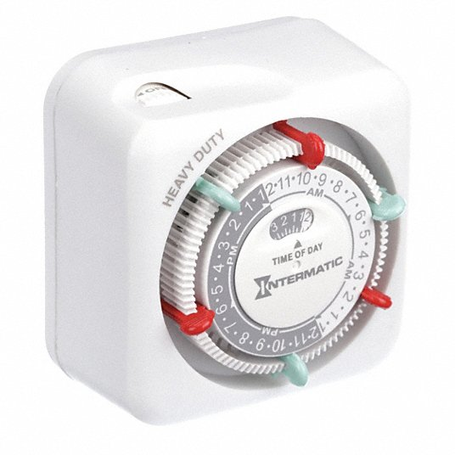
Make it Automatic
Case Study in an Immunology Lab
24 outlet timers were installed on 23 water baths and one heat block
It was found that the outlet timers resulted in a total savings of 4,800 kWh or $630 per year
The energy savings is equivalent to the greenhouse gas emissions from driving nearly 9,000 miles per year
Tip: choose an outlet timer that automatically resets after an override, so you don’t end up turning it off
Timer Examples
9

Slide 10
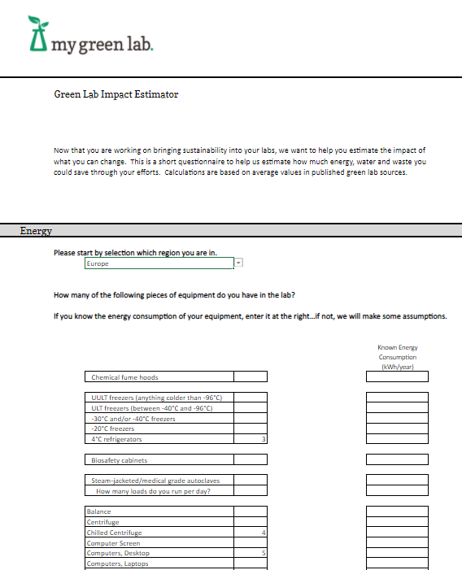
Get to Know Your Energy Consumption
Understanding Plug Load
Helps you know where energy is being used
Provides motivation for turning things off
Aids in prioritizing replacements
Supports optimization of equipment numbers
Use our plug load estimator or ask your vendors for data
10

Slide 11
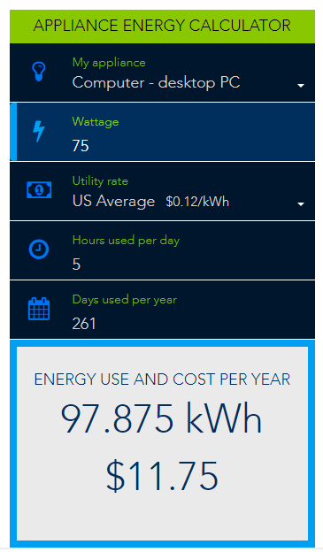
Get to Know Your Energy Consumption
Understanding Plug Load
Helps you know where energy is being used
Provides motivation for turning things off
Aids in prioritizing replacements
Supports optimization of equipment numbers
Try this calculator – pick any appliance and set the wattage (or current * voltage – 230V in Sweden); enter in hours used per day and days used per year (261 working days in a year)
11

Slide 12
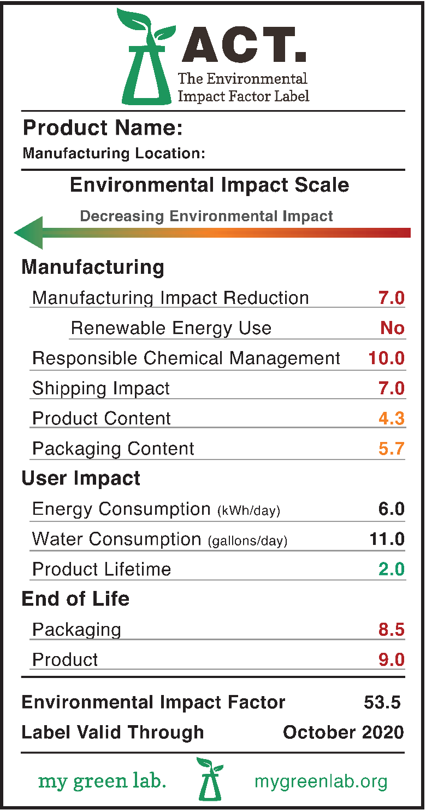
Replace Equipment With Energy-Efficient Options
Look Before You Buy
Energy labels: ACT, Energy Star
Look for energy-saving modes
Tell your vendors that this is important to you!

Slide 13
Let’s Choose Awesome!
X
11%
chart from Alison Farmer, kW Engineering
13

