Slide 1
Building a global culture of sustainability in science
Resources
Cold Storage Sample Inventory Ideas & Options
Inclusion of products and brands within this presentation is not an explicit or implied endorsement of any brand or product by My Green Lab. We recommend your lab evaluates options fully before making any purchases or decisions.

Slide 2
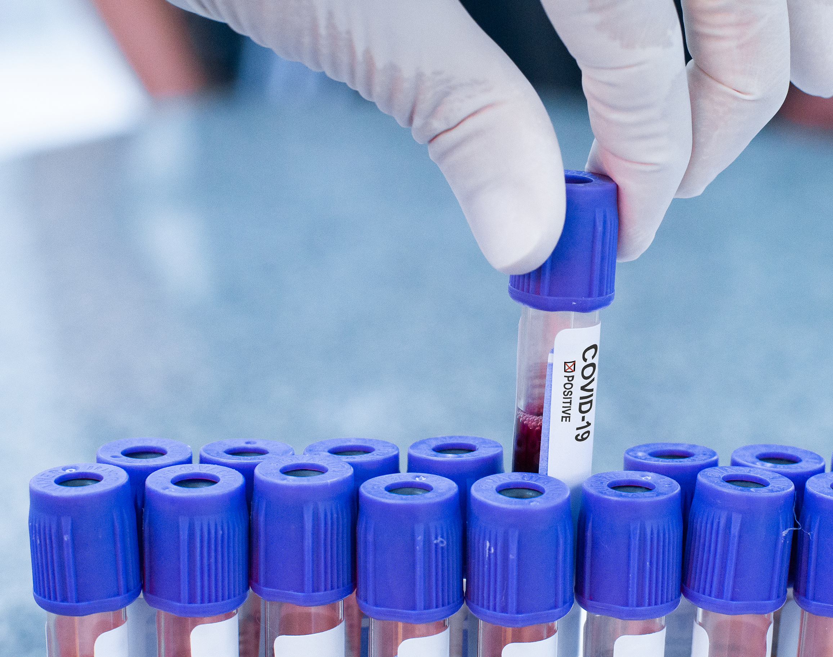
Decide What Features Your Lab Needs for an Inventory System
Electronic vs. Paper -> do you need it accessible from anywhere?
Are visual maps needed, or is a database with alpha-numeric organization system sufficient?
Do you need data privacy abilities within your lab, or with labs you share cold storage space with?
What sort of data do you need to track?
Sample Name and Type
Lab Member who is the "owner"
Date added to cold storage
Expiration date
Sample Location
What else?
How much (if anything) is your lab willing to spend?

Slide 3
The Benefits of Cold Storage Inventory
Saves scientists time! Find your samples quicker.
An accurate inventory allows you to keep your refrigerator and freezer doors open less while you are searching
This is better for your cold storage unit, as it doesn't have to work as hard to return to its setpoint
Better for your samples too, reducing risk of unit failure and reducing exposure to warmer temps
Sample inventories facilitate the periodic clean-out of old, expired, mislabeled, and duplicate samples, freeing up space in your cold storage units. This can save your lab money, as you are less likely to need to buy a new unit because you have run out of space
Your laboratory and institution are safer, because you know and have documentation of the types of scientific samples in your cold storage units. Added bonus -> Your EHS/SHE colleagues will love you!
If you ever need to move your lab to a new building or institution, having an up-to-date sample inventory will save a ton of time and effort prior to the move

Slide 4
Example Inventory Options
https://www.labguru.com/
https://www.freezerpro.com/
https://www.quartzy.com/
https://freezerworks.com/
Notes:
Chart to compare across companies instead of a different slide for each one

Slide 5
Inventory Option Comparison – Accurate as of Summer 2021
 | Sofware Download, or available in the Cloud? | Flexible & customizable? | Allows for within-box sample tracking? | Will help with database transition to new platform? | Automatic backups of database available? | Free? | Batch upload of samples? | Notification / alert system for task management and sample expiration?
Microsoft Excel | both
Quartzy | cloud
FreezerWorks | both |  |  |  |  | You can request a demo |  | partially
Labguru | cloud |  |  |  |  | You can request a demo
FreezerPro | cloud |  |  | No, but allows for import from common databases |  | Free trial

Slide 6
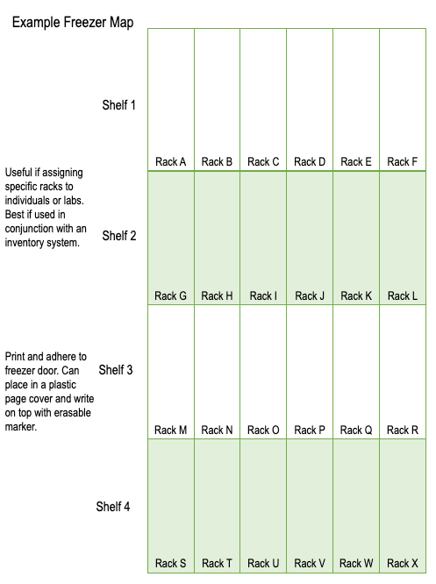
What About Freezer Maps?
A diagram of the shelf and rack orientation of the inside of your freezer, sometimes called a freezer map, can be a useful tool in addition to an inventory system. Usually, a lab will use a freezer map to indicate what racks in a freezer are assigned to a specific study or lab member.
However, as you can see by the example at left, even if you printed this map out and placed it on the front of your freezer, there is very little space available to detail sample type, expiration data, source contents, in addition to the name of the lab member who is tracking the sample. This is why a map is best used in conjunction with a detailed inventory system instead of as a stand-alone solution.
A couple examples of freezer maps, which you can modify, can be found here on SharePoint.

